Slide 1







ReviewSense AI
AI Engineer Bootcamp Project
From 50,000+ Reviews to 1 Smart Recommendation

Slide 2

Contents
01
The Pitch
05
Clusterer Model
02
Introduction & Methodology
06
Generative AI
03
Methods & Dataset
07
Results & Takeaway
04
DistilBERT Classifier
08
Live Demo
AI Engineer Bootcamp
02

Slide 3







ReviewSense AI
The Goal
From 50,000+ Reviews to 1 Smart Recommendation
Sentiment Analysis
Product Clustering
AI-Generated Buying Recommendations
(DistilBERT)
(MiniLM + KMeans)
(Generative AI)
"Stop reading thousands of reviews. Let AI summarize them for you."
AI Engineer Bootcamp
03

Slide 4




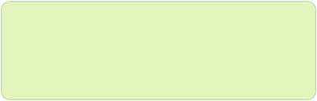

Project Overview
Pipeline Architecture
DistilBERT
Methodology
Classifies customer sentiment (Positive, Neutral, Negative)
Combines multiple AI models into one end-to-end review analysis pipeline
MiniLM + KMeans
Structured insights are used by Generative AI models to create short recommendation articles
Embeddings and clustering group similar reviews into broader product categories
Output: Top products, common complaints, and smart buying recommendations
GPT 4.1 mini
Generates actionable product recommendations and insights based on sentiment and clustered review data
AI Engineer Bootcamp
04

Slide 5





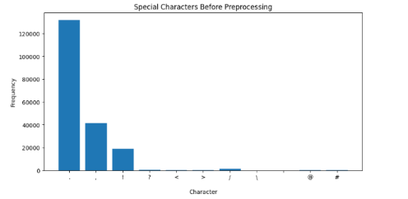
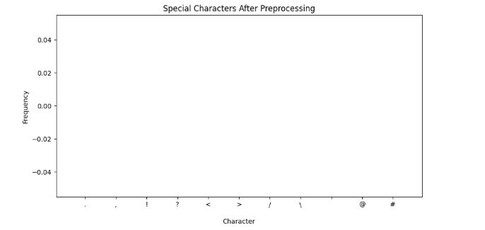
METHODS & DATASET
Overview
Preprocessing
Built an end-to-end NLP pipeline combining preprocessing, sentiment classification, semantic clustering, and Generative AI summarization
Cleaned review text by removing special characters, line breaks, punctuation, sentences shorter than 10 letters and inconsistent formatting
Dataset
Standardized text for model input
Amazon Reviews dataset containing product reviews, ratings, product names, and customer feedback
Special Characters Before Preprocessing
AI Engineer Bootcamp
5

Slide 6




Model 1: DistilBERT Sentiment Classifier
The Problem
The Solution
Customer reviews are highly unstructured and difficult to analyze manually at scale
Used DistilBERT, a transformer-based NLP model for sentiment classification
Companies need to automatically understand whether feedback is positive, neutral, or negative
Why DistilBERT? Lightweight, fast, and highly effective for text classification tasks
Manual analysis is time-consuming and inconsistent
Reviews were cleaned and labeled using review ratings, then used to train and evaluate the model
AI Engineer Bootcamp
06

Slide 7

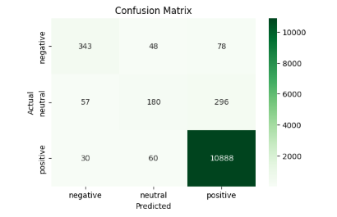



DistilBERT Performance Results
Results DistilBERT achieved strong classification performance with approximately 95% accuracy
Accuracy
Precision
0.953
0.946
Recall
F1-score
Chart: Confusion matrix visualization
0.953
0.948
(User will upload chart showing classification performance across sentiment categories)
Why It Works
DistilBERT understands word context and sentence meaning, helping detect sentiment more accurately even in complex reviews
Evaluation Method
Evaluated using Accuracy, Precision, Recall, F1-score, and confusion matrix
AI Engineer Bootcamp
07

Slide 8



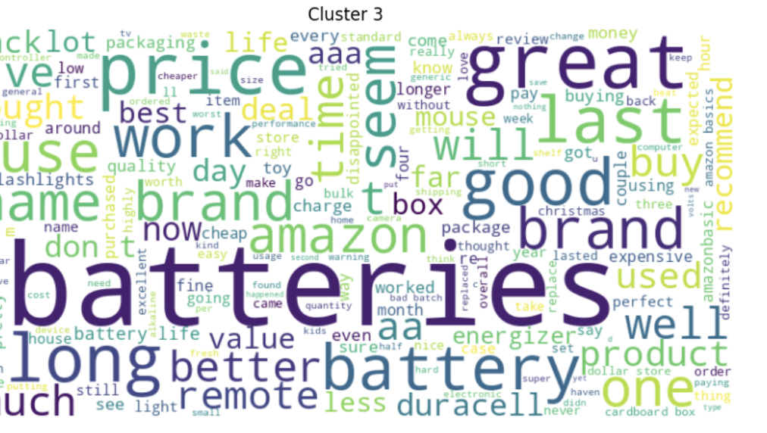






Model 2: Product Clustering
The Problem
The Solution
Too many products
1
Embeddings
Difficult to analyze individually
Created text embeddings using SentenceTransformers (all-MiniLM-L6-v2)
2
Clustering
Applied K-Means clustering algorithm
3
Grouping
Created 5 semantic product groups
Why This Works
Understands meaning, not just words
Automatically finds similar categories
Enables easier analysis and better recommendations
AI Engineer Bootcamp
8

Slide 9


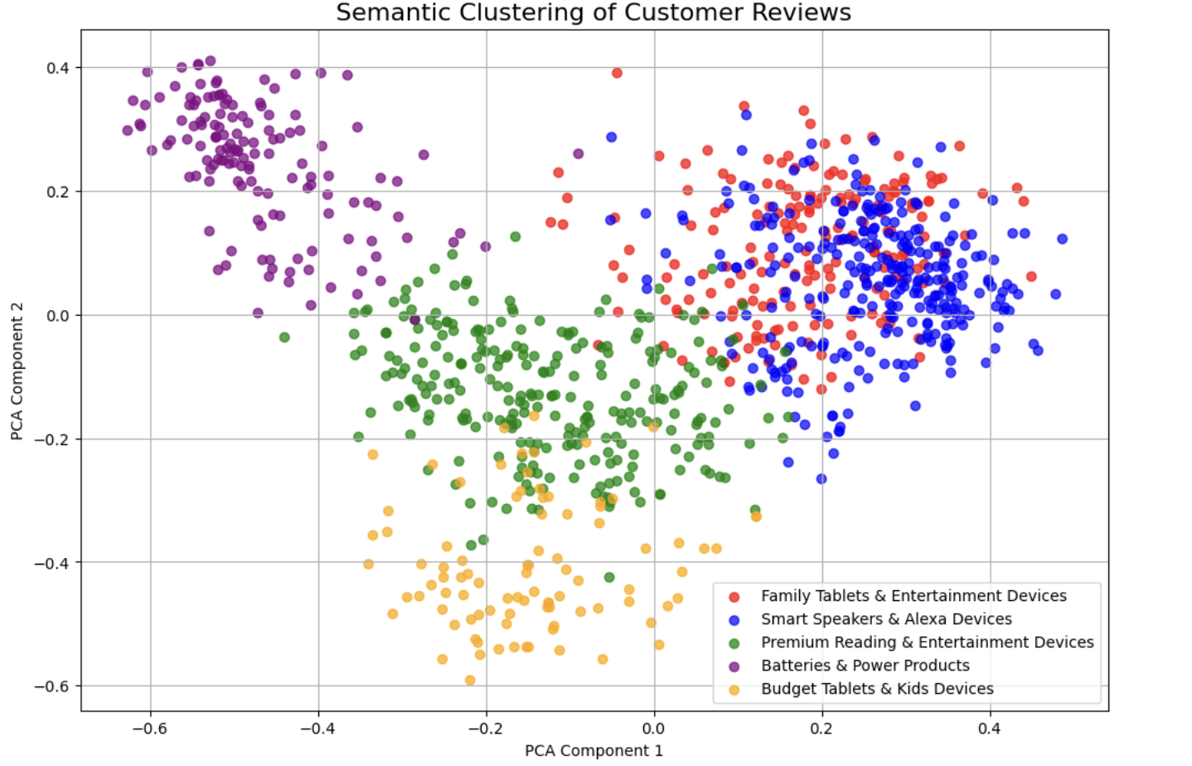




Clustering Results
Results
Silhouette score is relatively low (~0.07), indicating weak cluster separation. This is expected for text data, where reviews often share similar vocabulary
Evaluation Method
Visual inspection of clusters to assess semantic coherence and meaningful groupings.
Why It Works
Chart: Cluster Visualization
Semantic clusters are clearly visible in the visualization, showing meaningful product groupings.
Cluster Names
Named manually according to the patterns observed in the cluster visualizations.
AI Engineer Bootcamp
09

Slide 10





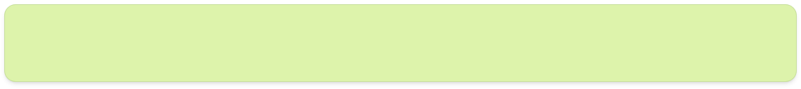

Model 3: AI-Generated Recommendations
The Problem
The Solution
Too many reviews to read manually
Prompt engineering: Asked the model to summarize customer opinions
Need automatic product recommendations per category
Identify best products based on sentiment and clustering results
Users want quick, actionable insights
Generate short, readable recommendation articles
Output
Concise articles with top products, common feedback, and buying recommendations
AI Engineer Bootcamp
10

Slide 11


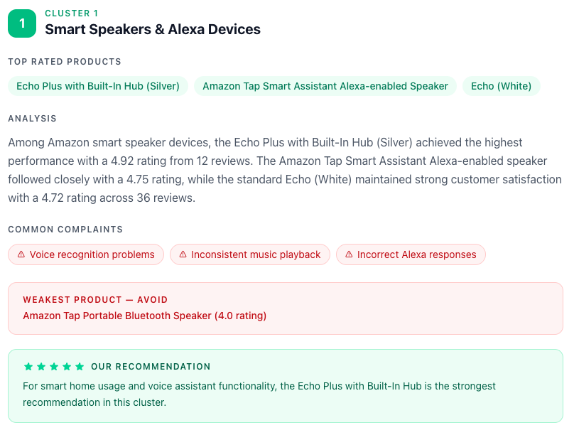





Generative AI Output
Evaluation Approach
Assessed quality of generated recommendation articles based on relevance, readability, and actionability.
Sample Output
AI-generated recommendation articles combining sentiment analysis, clustering insights, and product recommendations.
Key Features
Concise summaries of customer opinions
Top/Weakest products highlighted
Common complaints identified
Clear buying recommendations
AI Engineer Bootcamp
11

Slide 12
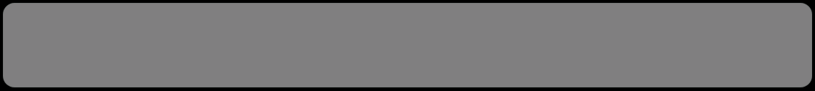

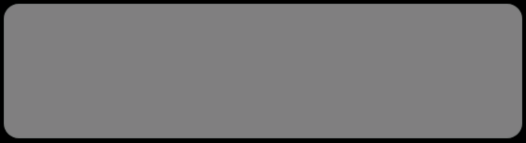

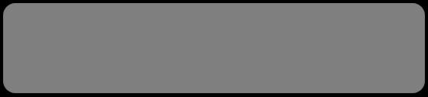


Project Recap
ReviewSense AI successfully combines three AI models (DistilBERT, MiniLM+KMeans, Generative AI) into a complete review analysis pipeline
Final Version
Key Takeaway
End-to-end system that transforms 50,000+ unstructured reviews into actionable product recommendations
Multi-model NLP pipelines can automate complex analysis tasks and deliver real value to users
Bonus Point
From data chaos to clarity — that's the power of AI! ✨
The system is scalable and can be adapted to any product category or review dataset
AI Engineer Bootcamp
12

Slide 13


Live Demo
What You'll See:
Top products per cluster
Our recommendation
most usual complaints
Final AI-generated recommendation article
AI Engineer Bootcamp
13

Slide 14

Thank You
ReviewSense AI — AI Engineer Bootcamp Project
Questions?

